Slide 1


Introduction to Model Optimization
Model optimization is the process of fine-tuning a machine learning model to achieve the best possible performance. This involves techniques like cross-validation, which help identify the optimal model configuration and hyperparameters.
Notes:
1

Slide 2

Understanding Cross-Validation
1
Data Split
The dataset is divided into training and validation sets to assess model performance.
2
Iterative Evaluation
The model is trained on the training set and evaluated on the validation set.
3
Performance Metrics
Metrics like accuracy, precision, and recall are used to measure the model's effectiveness.
Notes:
2

Slide 3

Objectives of Cross-Validation
Avoid Overfitting
Tune Hyperparameters
Cross-validation helps identify models that perform well on unseen data, not just the training set.
It enables the systematic exploration of different model configurations to find the optimal setup.
Estimate Generalization
Robust Evaluation
Cross-validation provides a reliable estimate of how the model will perform on real-world data.
It ensures a more comprehensive and unbiased assessment of the model's capabilities.
Notes:
3

Slide 4
K-Fold Cross-Validation
Data Partitioning
Iterative Training
Performance Averaging
The dataset is divided into k equal-sized subsets or "folds".
The model is trained on k-1 folds and evaluated on the remaining fold.
The evaluation metrics are averaged across all k iterations to get a reliable estimate.
Notes:
4

Slide 5
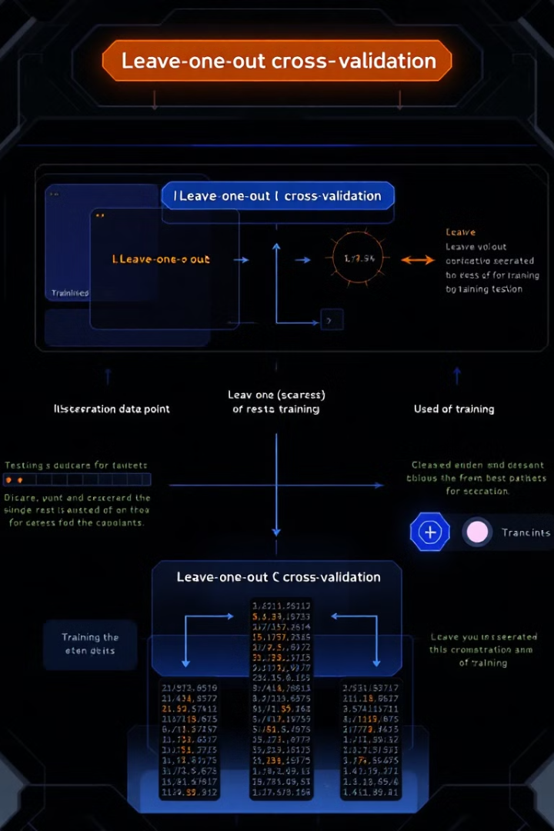



Leave-One-Out Cross-Validation
Iterative Holdout
In each iteration, a single data point is held out for testing while the model is trained on the remaining data.
Performance Aggregation
The evaluation metrics are combined across all iterations to estimate the model's true performance.
Unbiased Evaluation
Leave-one-out provides an almost unbiased estimate of the model's generalization ability.
Notes:
5

Slide 6





Implementing Cross-Validation in Python
scikit-learn
Jupyter Notebooks
The scikit-learn library provides built-in functions for various cross-validation techniques.
Jupyter Notebooks allow for seamless integration of code, visualizations, and explanations.
Data Preprocessing
Model Selection
Proper data handling and feature engineering are crucial for effective cross-validation.
Cross-validation helps identify the most suitable model architecture and hyperparameters.
Notes:
6

Slide 7

Evaluating Model Performance using Cross-Validation
Metric
Fold 1
Fold 2
Fold 3
Mean
Accuracy
0.85
0.82
0.88
0.85
Precision
0.88
0.84
0.91
0.88
Recall
0.83
0.80
0.86
0.83
Notes:
7

